Slide 1
NCWBLA 2021 Summer Mini-Conference “Nudging Toward Normalcy”
President – Jeanette Nunnery
Past President – Kathy Frederick
Vice President – Jimmie Griffith
Treasurer – Sherry Irsik
Secretary – Lynda Civils
Directors at Large – Joy Morrow and James Carter

Slide 2
Summer Mini-Conference Agenda
8am – Welcome and Housekeeping– NCWBLA President: Jeanette Nunnery
8:15am - Keynote Speaker Dr. Michael Walden - Economic Outlook: Welcome to The Post-Pandemic Economy
10am - Break (10 Minutes)
10:10am - Membership Fee Structure Proposal
10:30Am - Fall Conference Survey: Membership Topics of Interest
10:35am - NCWBLA Committees and Openings
Session 2
10:40am - Compliance Review Round Table Member Dialogue
9am - College Central Network From a Community College Perspective – James Carter Alamance CC
Session 1

Slide 4
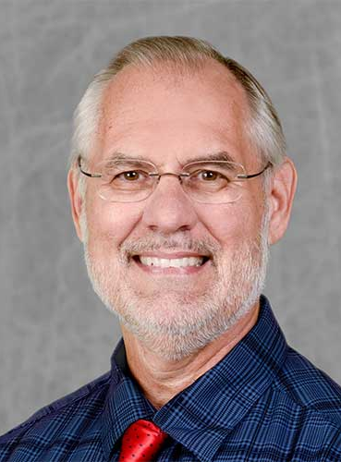
Dr. Mike Walden, William Neal Reynolds Distinguished Professor Emeritus North Carolina State University

Slide 5
GETTING INDIVIDUALS BACK TO WORK AFTER COVID-19
Dr. Mike Walden Reynolds
Distinguished Professor Emeritus - North Carolina State University
Notes:
OPENING JOKE: PARAPHRASING GEORGE BURNS: A GOOD SPEECH HAS A GOOD BEGINNING, A GOOD ENDING, AND LITTLE IN-BETWEEN

Slide 6
THE VIRUS IS RETREATING AND THE ECONOMY IS GAINING
CASES, HOSPITALIZATIONS, & DEATHS TRENDING DOWN
VACCINATIONS ARE UP
RESTRICTIONS ARE EASING
JOBS & ECONOMIC ACTIVITY ARE TRENDING HIGHER
FEDERAL GOVERNMENT PUMPING IN MONEY
HOPES RISE FOR A MORE NORMAL LIFE

Slide 7
BIGGEST WORRY: VARIANTS HIT BEFORE VACCINATIONS PROTECT US
WORST CASE SCENARIO:
ECONOMY IS OPENED BEFORE
ENOUGH ARE VACCINATED,
LEAVING DOOR OPEN TO VARIANTS
A FOURTH SURGE?

Slide 8
RECESSION WAS DEEP BUT SHORT
LARGE NEGATIVE GROWTH IN SECOND QUARTER 2020
BUT QUICK REBOUND IN THIRD QUARTER 2020

Slide 9
MONTHLY CHANGE IN NON-FARM EMPLOYMENT, US & NC
US, Change in millions
NC, Change in thousands
Notes:
US; Dec: -145,000 jobs. NC; Jan: -3000

Slide 10
MONTHLY CHANGE IN NON-FARM EMPLOYMENT, AS A PERCENT OF FEBRUARY TOTAL EMPLOYMENT, US, NC
Notes:
US; Dec: -0,1%

Slide 11
UNEMPLOYMENT RATES, US, NC
Notes:
But March 2021 is 5.5% if include individuals who left labor force in the month.

Slide 12
TRENDS IN NC LABOR FORCE PARTICIPATION RATE (%)

Slide 13
ECONOMIC SECTOR DIFFERENCES: EMPLOYMENT AS PERCENT OF FEBRUARY 2020 EMPLOYMENT (NORTH CAROLINA)
Sector May 2020 May 2021
All 88% 96%
Construction 95% 100%
Manufacturing 90% 97%
Retail Trade 88% 100%
Information 95% 101%
Financial Services 97% 100%
Professional Services 91% 100%
Education/Health 90% 95%
Leisure/Hospitality 55% 85%
Other Services 74% 93%
Government 97% 94%

Slide 14
IRONY: SOME FIRMS HAVING TROUBLE HIRING
POSSIBLE REASONS:
FORMER EMPLOYEES FOUND OTHER JOBS
UNEMPLOYMENT COMPENSATION IS HIGHER THAN SALARY
ENGAGED IN CHILD CARE

Slide 15
THE FEDERAL RESPONSE: $6 TRILLION IN SPENDING
ALL BORROWED
$81 BILLION TO NC
FUTURE ECONOMIC GROWTH WILL BE LOWER
BUT ALTERNATIVE: LOSE BIG PART OF ECONOMY
TODAY FUTURE

Slide 16
LONG-RUN WORRIES
STOCK MARKET OVER-VALUED?
HIGHER INFLATION AND INTEREST RATES COMING?
LOWER-VALUED DOLLAR?
TEST OF “MODERN MONETARY THEORY”?

Slide 17
AT SAME TIME, THERE ARE PERMANENT BUSINESS IMPACTS FROM THE PANDEMIC
ACCELERATION OF ON-GOING TECHNOLOGICAL UNEMPLOYMENT
BUSINESSES WILL SEE A NEW LIABILITY FROM USING HUMAN WORKERS

Slide 18
AS A RESULT
WE ARE LIKELY FACING A MAJOR
NEED FOR WORKER RE-TRAINING
* FOCUSED
* FAST
*FLEXIBLE

Slide 19
METHODS
APPRENTICESHIPS
ON-THE-JOB TRAINING SKILL AND TASK TRAINING
COMMUNITY COLLEGES WILL BE MAJOR LEADERS IN THESE EFFORTS
PUBLIC/PRIVATE PARTNERSHIPS

Slide 20
DESIRABLE SKILLS IN TODAY’S ECONOMY
DATA ANALYSIS
PROBLEM-SOLVING
COMMUNICATION SKILLS

Slide 21
SECTORS WITH RAPID JOB GROWTH
TECHNOLOGY – CLOUD COMPUTING
ROBOTICS
LOGISTICS – DATA MANAGEMENT & ANALYSIS
PRODUCT MOVEMENT & DELIVERY
HEALTH CARE – CARE, TESTING, ANALYSIS
ENERGY – RENEWABLE
MARKETING – NEW METHODS
PRODUCT DEVELOPMENT

Slide 22
BIG CHANGES IMPACTING JOB TRAINING

Slide 23
BIG IMPLICATIONS FOR EDUCATION
SOME LEVEL OF DISTANCE LEARNING IS HERE TO STAY AT ALL LEVELS OF EDUCATION
SHOULD GET BETTER
EDUCATION
RE-MADE

Slide 24
TELE-WORKING
8% PRE-VIRUS
40% AT PANDEMIC PEAK
20% - 30% LONG-RUN LEVEL
WATCH HOW INTERNET IS PROVIDED
WORK – HOME
BALANCE

Slide 25
DRONE DELIVERY OF PRODUCTS; INTERNET DELIVERY OF SERVICES
AVOIDS FACE TO FACE CONTACT
NEXT: 4D HOME MANUFACTURING
IMPLICATIONS FOR
CONTROL OF THE SKIES

Slide 26
RECONSIDERATION OF RESIDENTIAL LOCATION
“DISTANCE IS DEAD”
PROXIMITY TO WORK, SCHOOLS, SHOPPING NO LONGER NEEDED
“NEW FARM LIFESTYLE” ON CHEAPER LAND
INTERNET FROM THE SKY?
WHERE IS HOME ?

Slide 27
IMPLICATIONS FOR NORTH CAROLINA
CONTINUED GROWTH –PERHAPS ACCELERATED – AFTER THE PANDEMIC
NORTH CAROLINA CONSIDERED A “SAFE STATE”
LOOK FOR SUBURBS TO HAVE FASTEST GROWTH
NEXT GAME-CHANGER – UNIVERSALLY AVAILABLE HIGH-SPEED INTERNET – COULD
INCREASE RURAL GROWTH
INFRASTRUCTURE BILL – CONTENTS? PAYMENT? NEW FEES? MILEAGE FEE?

Slide 28
“REAL SOLUTONS” IS NOW AVAILABLE

Slide 29
…AND SO IS “DISUNIONIA”

Slide 30
NCWBLA Program Spotlight – Surry CC

Slide 31
Session 1: College Central Network From a Community College Perspective Presenter: James Carter WBL Coordinator at Alamance CC

Slide 32
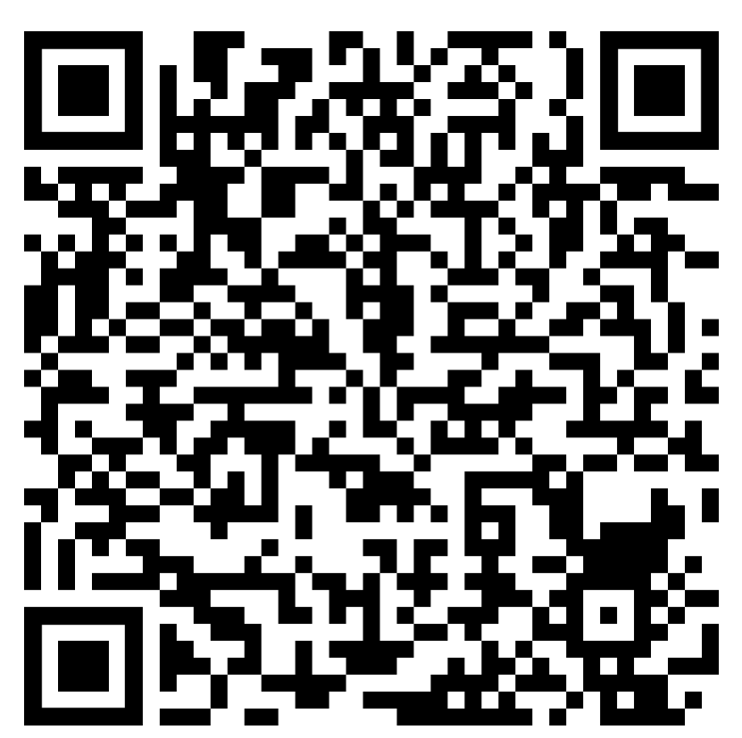
Compliance Questions
Scan the QR Code below with your phone's camera or click on the link shared on the chat box
Select open to access the shared Google Doc, when prompted on screen

Slide 34
Membership Fee Structure​
Per NCWBLA Constitution:​
www.NCWBLA.org → members page (login) →Available Documents → NCWBLA Constitution
Article IV – Membership (p.4)​
​

Slide 35
Membership Fee Structure Discussion
CURRENT​
PROPOSED​
Individual – $25​
Organizational (2) - $40
Organization​ - membership levels
Bronze (2) - $40
Silver (4) - $75​
Gold (6) - $100
Individual - $25​

Slide 36
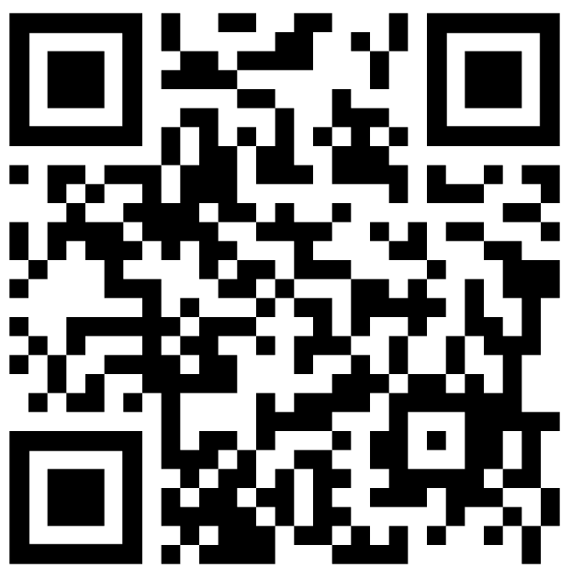
NCWBLA Tier Membership Proposal (Motion to accept)
Scan the QR Code below with your phone's camera ​or click on the link shared on the chat box

Slide 37
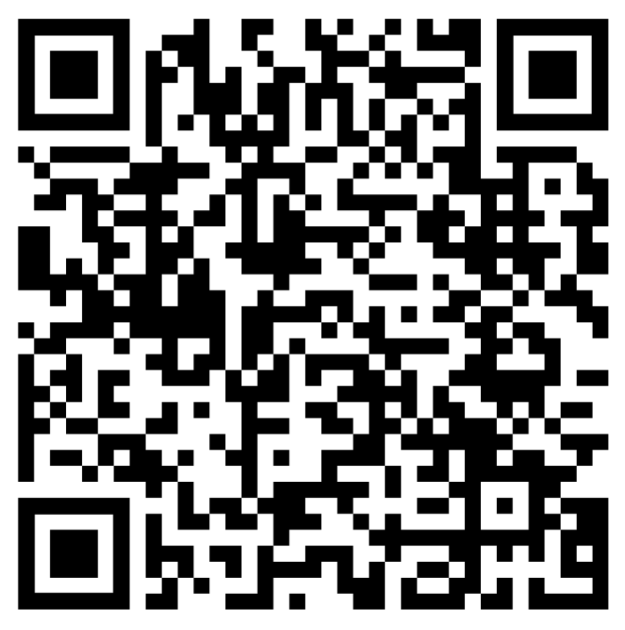
NCWBLA Fall Conference Survey
Scan the QR Code below with your phone's camera or click on the link shared on the chat box ​
​
​
​
​
​
​
​
​
​
​
Select open to access the shared Google Doc, when prompted on screen​
Save the date - November 3-5, 2021 (location TBD)

Slide 38
Award Nominations and Committee Openings
2021 NCWBLA Awards (www.NCWBLA.org)
The Outstanding Employer Award
The William D. Weston Awards
Outstanding WBL Student of the Year
The Jon A. Young Award
Outstanding NCWBLA Member of the Year
Deadline Friday, October 8th
Email: ksfrederick1@waketech.edu

Slide 39
Award Nominations and Committee Openings
NCWBLA Committees Summary (www.NCWBLA.org)
Awards Committee
Review the nominations and select the recipient of the awards.
Nominations Committee
Recruit members to serve on the NCWBLA Board.
Historical Committee
Responsible for recording the historical events of the Association.

Slide 40
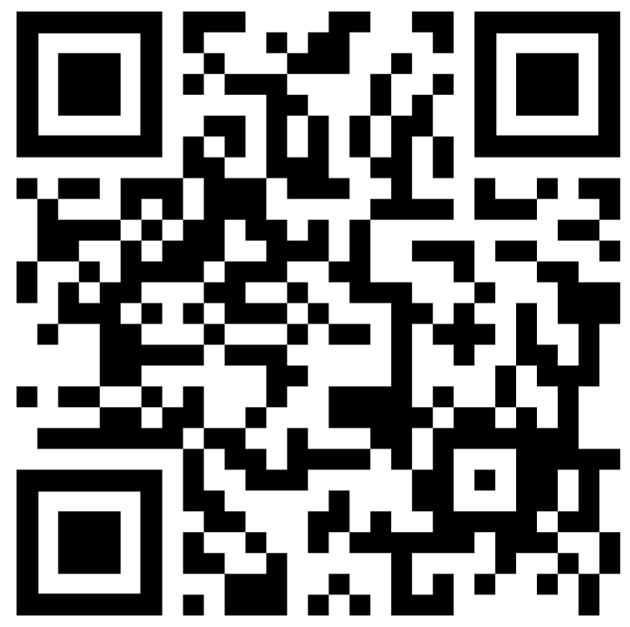
Award Nominations and Committee Openings
NCWBLA Committees Summary (Continued)
Membership Committee
Responsible for Association’s membership and designing the annual NCWBLA Membership Directory.
Technology/Publicity Committee
Promote NCWBLA in a variety of ways.
Program Committee
Plan the program for the NCWBLA Annual Conference with the leadership of the Board President and/or Vice President
Please volunteer using QR code or link shared in the the chat box
*$50 and $25 Amazon card drawing (1 year service)

Slide 41
Session 2: Compliance Discussion Round Table Moderator: Sherry Irsik

Slide 42
Ground-Rules - Summary
1) Microphones are muted to minimize background noise unless you are speaking.
2) Use the “raise hand” feature. The moderator will call you when the last person has finished speaking.
3) Do not interrupt an individual who is speaking.
4) Respect the thoughts and opinions of other NCWBLA members
5) If your question was unable to be answered today, we will forward it to the appropriate person and post at www.NCWBLA.org - Member Page. Please allow a reasonable time for the answer.
6) This is a “sharing” session and all information should be referenced back to Section 20 for accuracy.

Slide 43
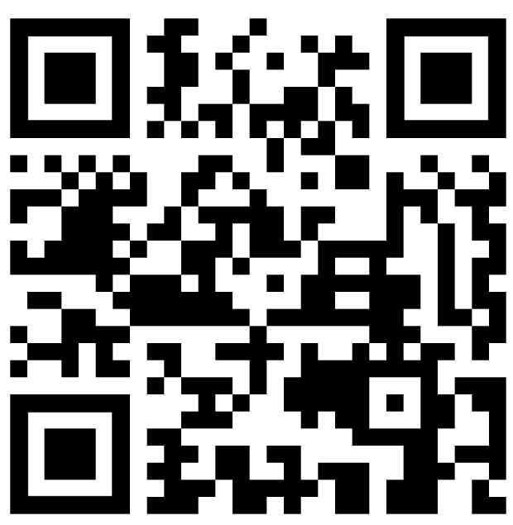
Thank you!
Please take our post-conference survey by scanning QR code or clicking on the link shared in the chat box.

